Slide 1


Zomato Project Analysis
Welcome to the Zomato Project Analysis! This presentation will delve into the insights gained from analyzing a dataset containing restaurant information, customer votes, ratings, and order modes. We will utilize Python for data exploration and visualization to gain a deeper understanding of the trends within the Zomato platform.
By Utkarsh Kashyap

Slide 2

Data Overview
Restaurant Name
Cuisine
Votes
Rating
Order Mode
Restaurant A
Indian
150
4.2
Online
Restaurant B
Chinese
200
3.8
Offline
Restaurant C
Italian
180
4.0
Online

Slide 3

Data Cleaning and Preparation
1
Duplicate Removal
Identifying and eliminating duplicate restaurant entries to ensure data accuracy and prevent bias.
2
Missing Value Imputation
Addressing missing values in columns like votes, ratings, and order mode using appropriate imputation techniques.
3
Format Standardization
Converting data formats to ensure consistency across the dataset for easier analysis and visualization.

Slide 4
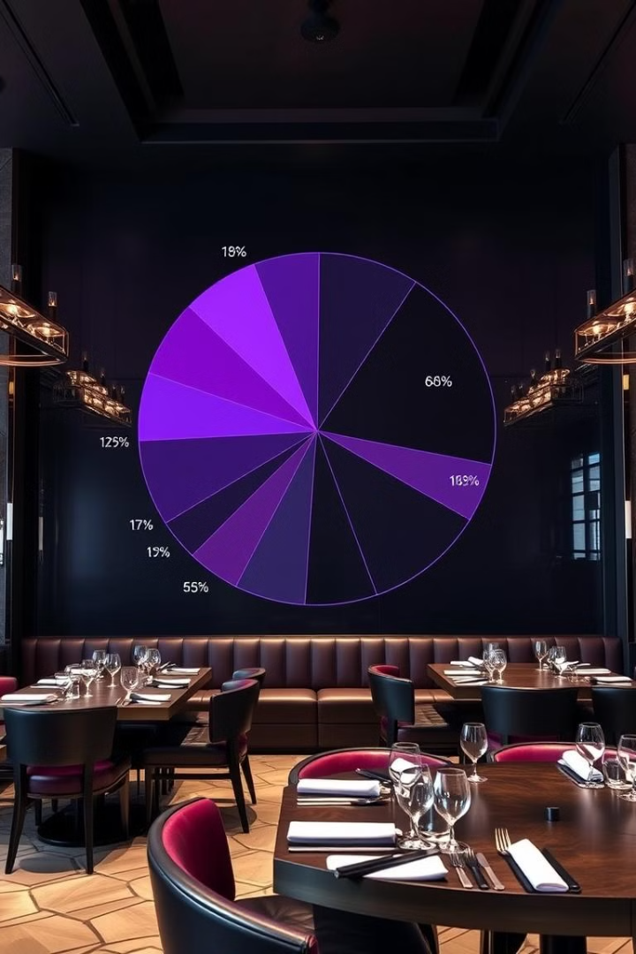
Restaurant Type Distribution
1
Dining
Represents the majority of restaurants, offering a full-service dining experience.
2
Fast Food
Popular choice for quick and casual meals, often with a focus on affordability and convenience.
3
Cafes
Serve beverages like coffee, tea, and pastries, along with light meals.
4
Others
Includes a variety of restaurant types beyond the main categories, such as bakeries, ice cream shops, and more.

Slide 5
Vote Analysis
Dining
Fast Food
Cafes
High vote count, reflecting the popularity of full-service restaurants among customers.
Significantly high vote count, indicating the popularity of fast food options for quick meals.
Moderate vote count, showcasing the appeal of cafes for casual gatherings and coffee lovers.

Slide 6
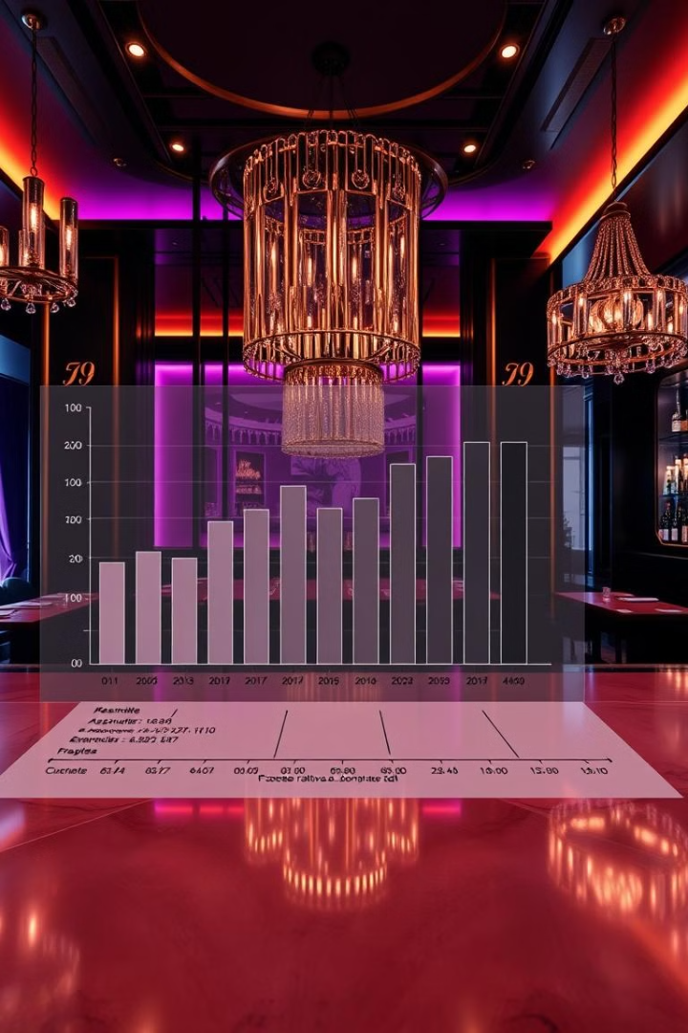
Rating Distribution
Majority of Ratings
The majority of restaurants fall within a rating range of 3.25 to 4.00, indicating a generally positive customer experience.
High Ratings
A notable number of restaurants achieve ratings above 4.00, showcasing exceptional customer satisfaction.
Lower Ratings
A smaller portion of restaurants receive ratings below 3.25, indicating areas for improvement in service, quality, or overall experience.

Slide 7
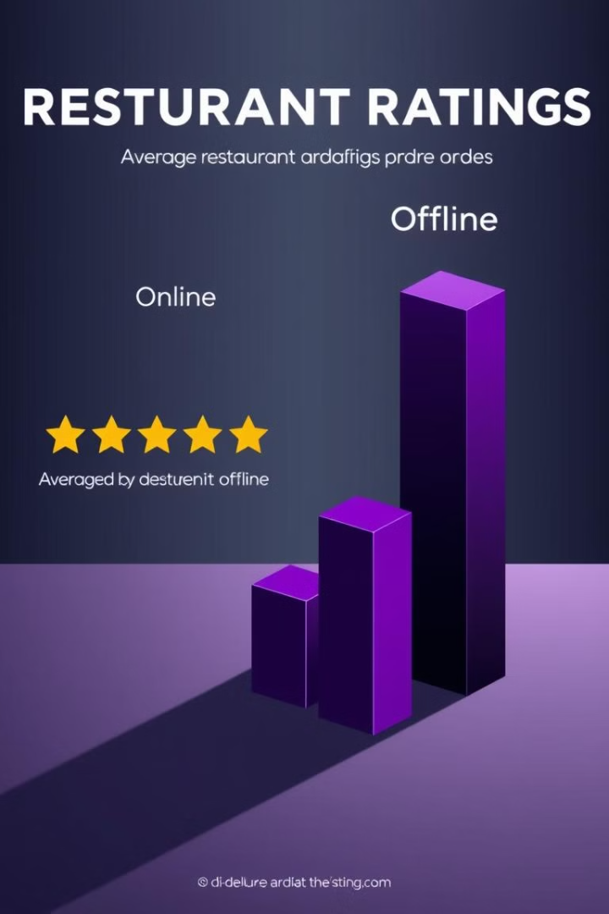


Mode of Orders (Online/Offline)
Offline Orders
Higher average ratings suggest a potentially better customer experience for offline orders.
Online Orders
Lower average ratings compared to offline orders may indicate areas for improvement in online order fulfillment, delivery, or customer service.

Slide 8





Key Findings and Recommendations
Dining Restaurants Popularity
Dining restaurants dominate in terms of customer orders and votes, indicating a strong preference for full-service dining experiences.
Rating Consistency
Most restaurants fall within a consistent rating range of 3.25 to 4.00, suggesting a generally positive perception of the platform.
Offline Order Advantage
Offline orders consistently receive higher average ratings, indicating a possible need to improve online order processes.
Focus on Online Experience
Enhance online order experience to improve customer satisfaction and boost ratings.
Marketing Strategies
Leverage the popularity of dining restaurants through targeted marketing strategies.

